Slide 1
Functional Food for prostate cancer
Japan Urology Association
COI disclosure
Seiji Ohmura
I declare that there are no conflicts of interest associated with this presentation.

Slide 2
Introduction
The bill which Medical Institute shall be allowed to sell health food products passed on June 26, 2014, and hence further knowledge on them is required.
However, despite of many evidences of efficacies of functional food provided by basic and epidemiological studies, clinical trials indicated inadequacy to draw clear conclusions not even meeting the guideline of prostate cancer treatment, and there are few contradicting results to provided data.
To scientifically respond to prostate cancer patients’ uneasiness and their needs, we need to summarize our past knowledge towards functional food (others). Here I would like to introduce the newest information on Citrus-peel extract which is expected to be effective for primary and secondary protection.

Slide 3
Prostate Cancer; Categorized Functional Foods
 | Major element | Product name
A) Anti-tumor effect | soy bean isoflavon
 | citrus peel extract | GL: Gold Lotion
Binhibit VEGF | liquid cartilage cell sap of shark | Car T Cell Plus
C) Induction of Apoptosis | fucoidan | Afucoidan
D) Discharge effect of toxic materials | chitosan | tender ace
E) Improve immunity | agaricus | agaricus mushrooms
 | propolis | W biopolis
F) antioxidation effect | tea catechin | βcatechin
 | lycopin

Slide 4
Soybean Isoflavone
Please note that this page has been deleted for no relationship with citrus-peel extract study.

Slide 5
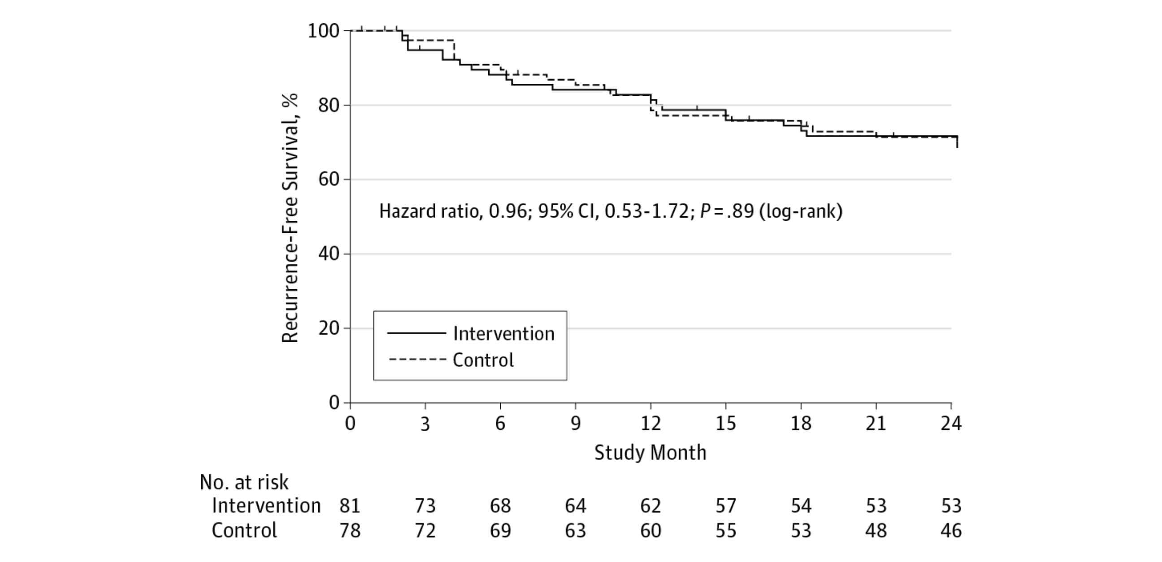
Effect of Soy Protein solate Supplementation on Biochemical Recurrence of Prostate Cancer After Radical Prostatectomy; A Randomaized Trial (JAMA 2013)

Slide 6
EPA Agent
Please note that this page has been deleted for not related with citrus-peel extract study.

Slide 7
Green tea’s catechin
Please note that this page has been deleted for not related with citrus-peel extract study.

Slide 8
Lycopin
Please note that this page has been deleted for no relationship with citrus-peel extract study.

Slide 9
Citrus Flavonoids
1) Citrus Flavonoids have been of particular interest of study in recent years for functional food (product name: Gold Lotion, GL).. Methoxylated flavonoids are major compositions and known to have a broad spectrum of biological properties of ① anti-inflammation, ② anti-carcinogenesis, ③ anti-oxydant, ④ anti-thrombogenic, ⑤ anti-atherogenic.
2) It has been reported that both injection and oral applications of GL decreased the size of tumors clearly by mouse in vivo test using Prostate cancer cells (PC3 ).
3) At this conference Kageyama et al reported the case study resulted in decreased PSA after oral application of GL and therefore the further verification of efficacies is expected by clinical trials.

Slide 10
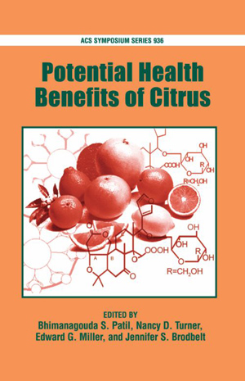
Bioactivity of citrus flavonoids
Citrus flavonoids are of particular interest because many of these flavonoids exhibit a broad spectrum of biological activity, including:
anti-inflammatory
anti-carcinogenic
anti-viral
anti-oxidant
anti-thrombogenic
anti-atherogenic properties.
Pharmacol. Rev. 2000; Atherosclerosis, 2005;
Biochem. Pharmacol., 2003
Notes:
Polymethoxyflavonoids posses many anti-inflammatory properties. They can scavenge free radical spices; inhibit some enzymes like matrix metalloproteinase-1, MMP-3 and MMP-9, prostalgladin enzyme-2, COX-2, iNOS etc; they can down regulate the activation of some transcription activators; also they can down regulate the over-expression of some protein mediators, such as some enzymes and some cytokines.
Chronic inflammation has been found to be associated with the increased risk of cancer at various sites. Inflammation causes the activation of variety of inflammatory cells, which in turn induce and activate several oxidant-generating enzymes, such as NADPH oxidase, iNOS, myeloperoxidase and eosinophil peroxidase. These enzymes generate high concentrations of diverse free radicals and oxidants including superoxide anion, nitric oxide, nitroxyl, nitrogen dioxide, hydrogen peroxide, hypochlorous acid and hypobromous acid. These free radicals and oxidants react each other and produce other more potent ROS, RNS, such as peroxynitrile. The adverse effects of these reactive species are to damage DNA, RNA, lipids and proteins by nitration, oxidation, chloronation and bromination reactions, which leads to increased mutations and altered functions of enzymes and proteins, consequently, contributing to the multistage carcinogenesis process.

Slide 11
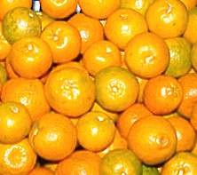
Citrus peel content
Pectin
Essential oil
Terpenoids: limonene, linalool, etc.
Other volatile oils
Flavonoids
Polyhydroxyflav(an)ones (PHFs)
PMFs – polymethoxyflavones
OH-PMFs
Carotenoids

Slide 12
Cancer prevention property of
PMFs and OH-PMFs
Inhibition of tumor cell proliferation
Human prostate, skin, mammary and colon carcinoma cell lines
Antiproliferative and apoptotic effects on gastric cancer cells
Disruptive effects on cell-cycle progression
Human umbilical endothelial cell migration and proliferation
Inhibition of NO, O₂⁻ and PGE₂ production and tumor promotion
Induction of apoptosis
Murakami et al, In Oxidative Stress and Disease, Bao and Fenwick Eds. 2004, 12, 187
Manthey et al, JAFC, 2002, 50, 5837; Lai et al, Carcinogenesis, 2007, 28(12), 2581

Slide 13
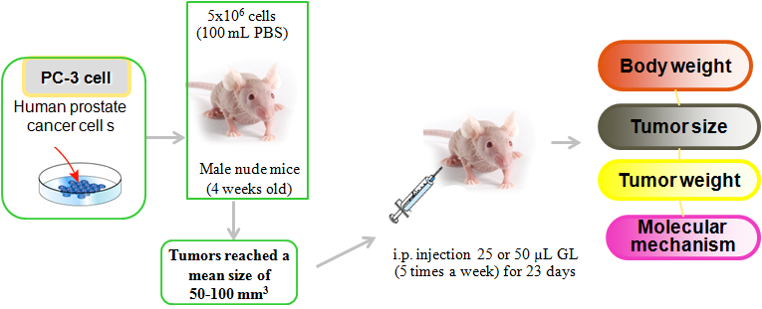
PC-3 derived xenograft model
Professor Min-Hsiung Pan, Taiwan University, Taiwan
Professor Chi-Tang Ho, Rutgers University, USA
Food & Function, 2013, DOI: 10.1039/c3fo60037h

Slide 14
Inhibition of prostate tumor growth in vivo
Body weight (g)
Tumor volume (mm³)
3082±680
659±211
**
***
Positive 25 μL 50 μL
Positive 25 μL 50 μL
Gold Lotion
Gold Lotion
PC-3 cells were injected subcutaneously between the scapulas of nude mice. Once tumor volume reached approximately 50 -100mm³, the animal received an injection of 25 or 50 µL GL five times per week for 23 days. Average body weight and tumor volume were measured at the end of experiment. Five samples were analyzed in each group, and value represent the mean ± SD. Significantly different at *P<0.05.
Pan et al, Food & Function, 2013, DOI: 10.1039/c3fo60037h
Miyauchi, 2013, US Patent No. 8,425,952

Slide 15
Inhibition of prostate tumor growth
Professors Ho &Pan, Food & Function, 2013, DOI: 10.1039/c3fo60037h

Slide 16
GL Oral Efficacy
16
Mice bearing human prostate cancer cell line PC-3 tumor xenografts
Miyauchi, 2013, US Patent No. 8,425,952

Slide 17
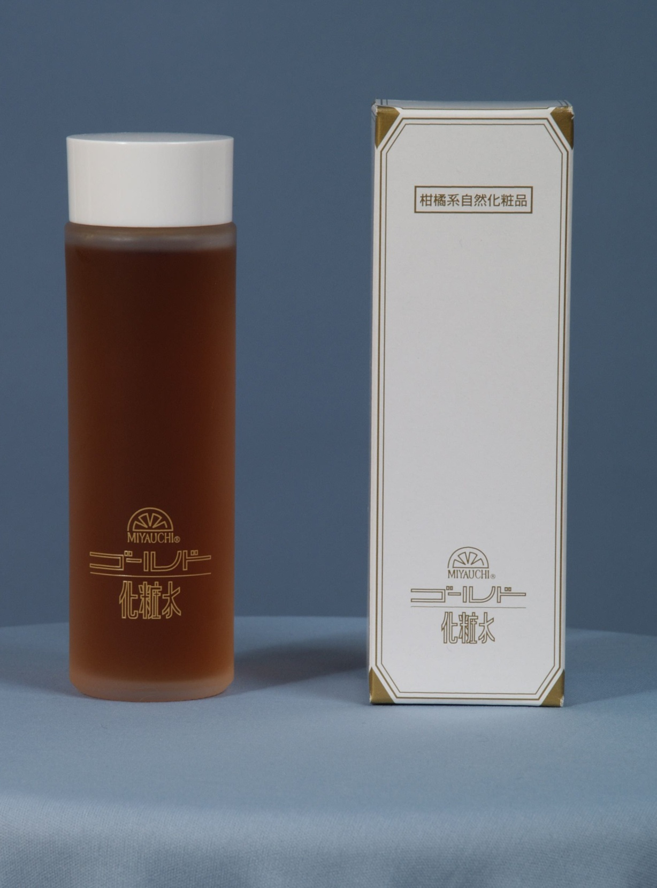
Gold LotionTM
17
Citrus extract produced in Japan
Unsyu Mikan
Limon
Navel orange, Hassaku,
Amanatsu
Miyauchi Iyo
Aloe

Slide 18
Prostate Cancer: supported case study of functional food
PSA Observation treatment 61 years old (currently 71 years ols)
Citrus peel extract
G3+4
G3+4

Slide 19
Conclusion
Presentation on Prostate cancer and Functional Food
Reported efficacies of isoflavone, lycopene, citrus peel flavonoids as typical examples of functional food by generated expectation which can be used as Primary Preventive measure of prostate cancer.
From recent studies, efficacies of citrus peel extract for anti-tumor activity have been elucidated, and the future development of further study including clinical trials as secondary preventive cancer treatment is expected.

