Slide 1
Japan Urology Association
Disclosure of COI
Presenter Shinji Kageyama, MD
I declare that there are no conflicts of interest associated with this study.

Slide 2
Acitive Surveillance
AS: chose progress observation approach rather than actual carcinostatic treatment
Feel uneasiness by patients
Received many inquiries by patients seeking for something better once PSA level increases

Slide 3
Case 61-year-old patient (presently 71 years old)
Patient’s Option: Observation of PSA level
History of disease:
In 2004 Biopsy at one hospital in Hamamatsu City and detected PSA 5.2 and found that G3+4 was 2/6. Diagnosis – T2aNoMo. Selected “progress observation” per his request.
In 2006 re-biopsy at the same hospital
Decided for continuation of “progress observation” for G3+4 was 1/6.
PSA increased to 7.2 at most; PSA stayed between 5 and 6
In April, 2013, a patient moved to Shizuoka City
Continued “progress observation” at my clinic
Present symptoms/test results: TG, LDL-C is a little higher than limits; otherwise, no mentionable symptoms

Slide 4
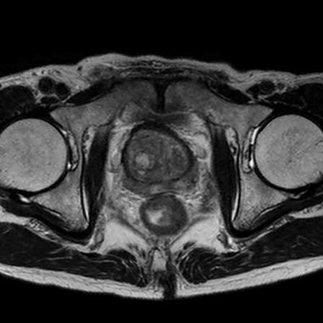
G3+4
G3+4
Began observation at my clinic
2/6
1/6
MRI

Slide 5
Treatment for Minimally Invasive Cancer
Metformin
Vit D
Curcumin
Agaricus
PDT
Peptide Vaccine

Slide 6
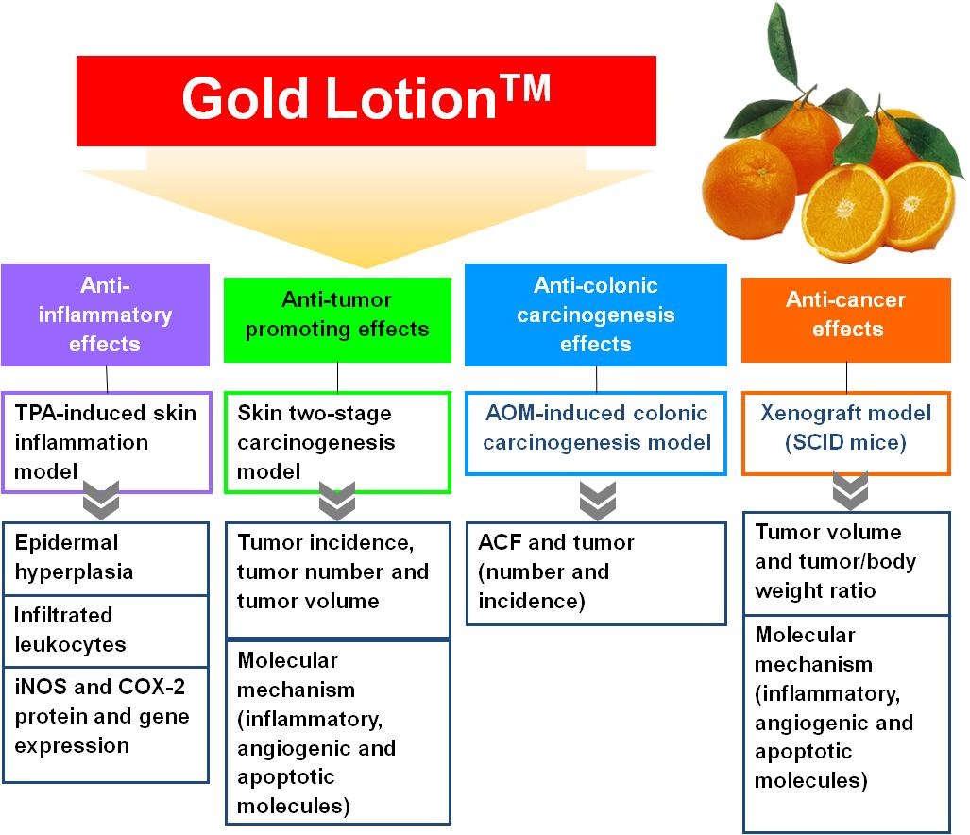

Slide 7
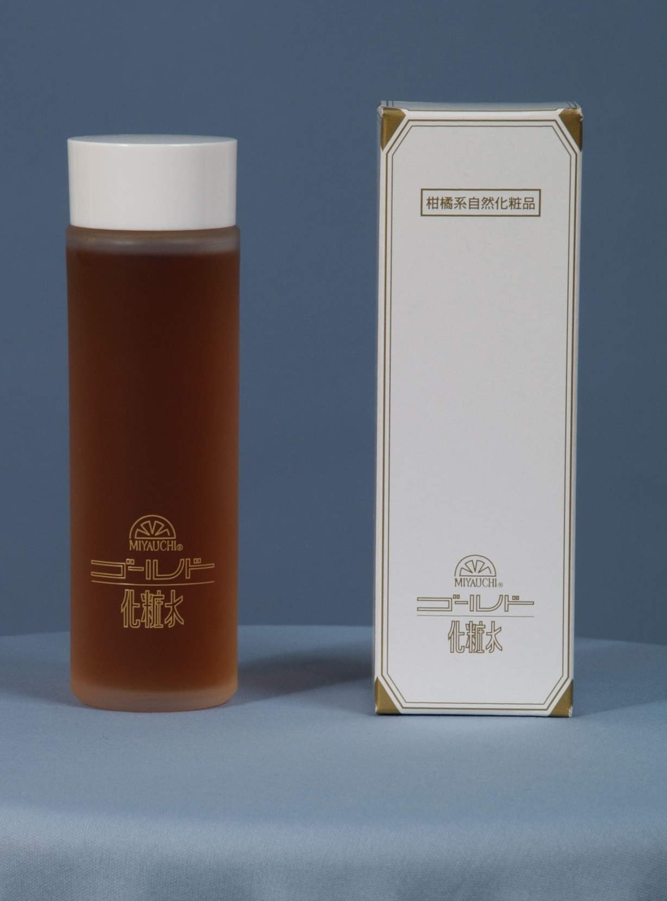
Gold LotionTM
7
Extract of Citrus produced in Japan
Unsyu Mikan (tangerin), Citrus limon, navel oranges, Citrus Hassaku, Citrus natsudaidai, Miyauchi Iyo hort, Aloe

Slide 8
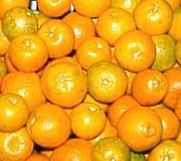
Compounds contained in Citrus Peel Extract
  Pectin
    anti-ulcer、disinfection、immune activation
  Essential oil
    Terpenoids: limonene, linalool, etc.
    other volatile oil
      antioxydation、disinfection
  Flavonoids
    Polyhydroxyflav(an)ones (PHFs)
    PMFs – polymethoxyflavones
      anti-immflamation、anti-carcinogenesis、antioxydation、anti-atherosclerosis effects
  Carotenoids
    Hesperidin
    Narindin
      Anti-cancer

Slide 9
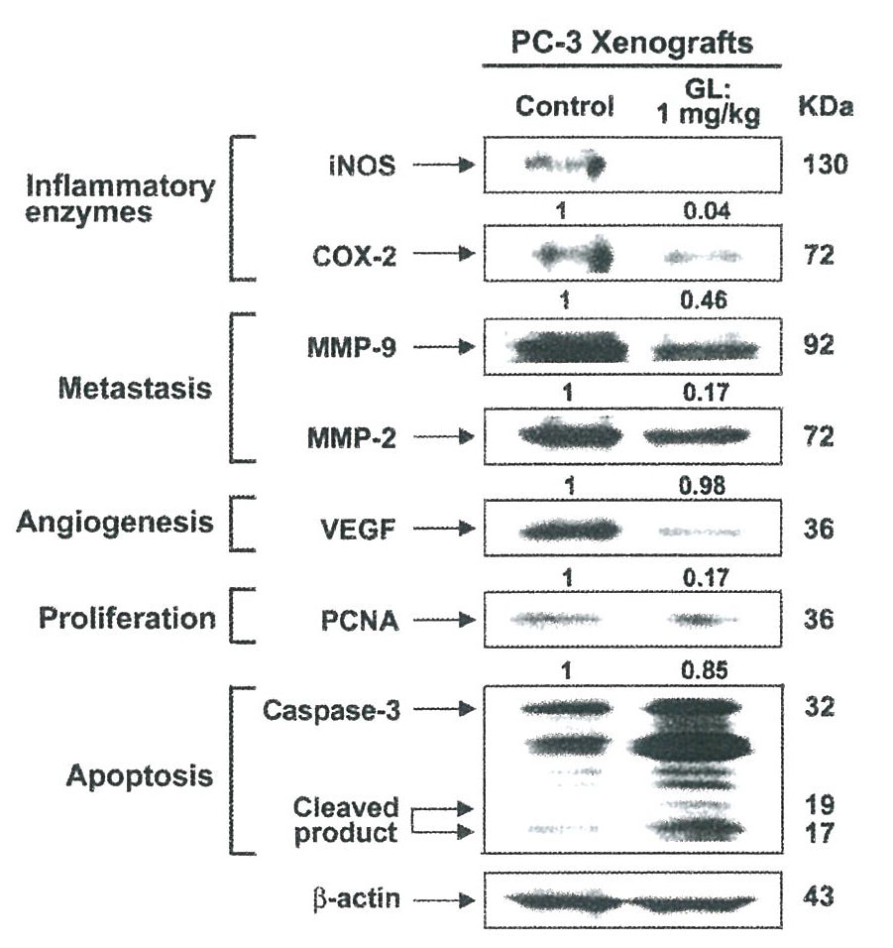
GLの各種パラメータに対する影響
Anti-
immflammation
Inhibit metastasis
Inhibit proliferation
Induction of
Apoptosis

Slide 10
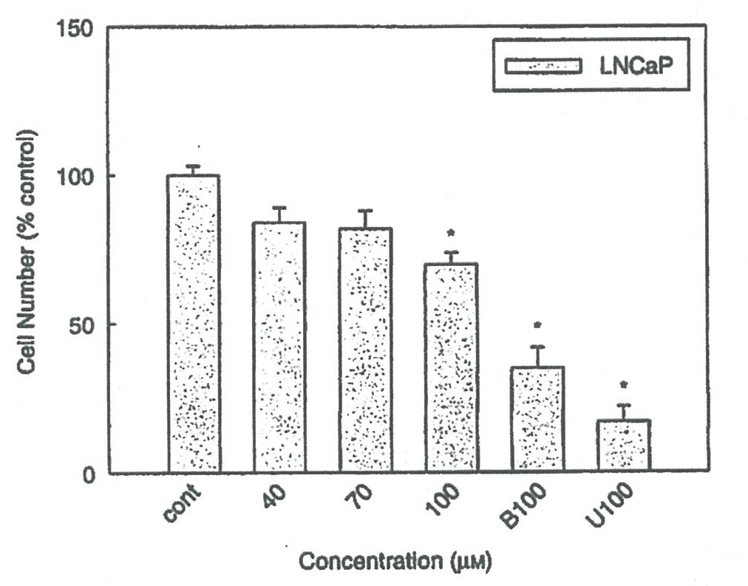
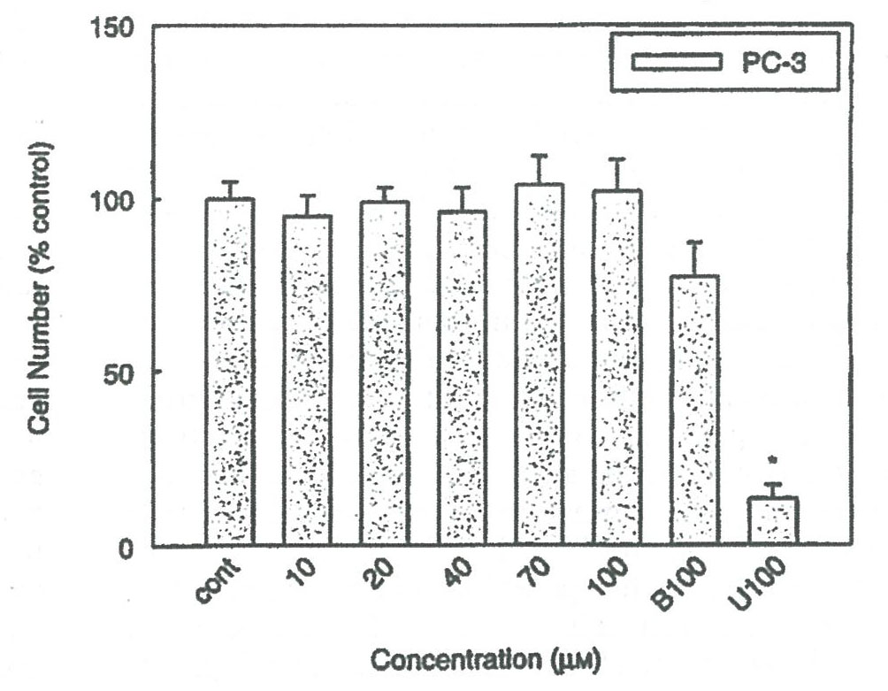
    Inhibition of LNCaP, PC-3 cell Proliferation by Hesperidin
Effective on both androgen dependent/non-dependent

Slide 11
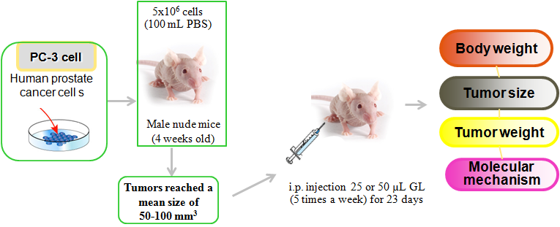
PC-3 derived xenograft model
Professor Min-Hsiung Pan, Taiwan University, Taiwan
Professor Chi-Tang Ho, Rutgers University, USA
Food & Function, 2013, DOI: 10.1039/c3fo60037h

Slide 12
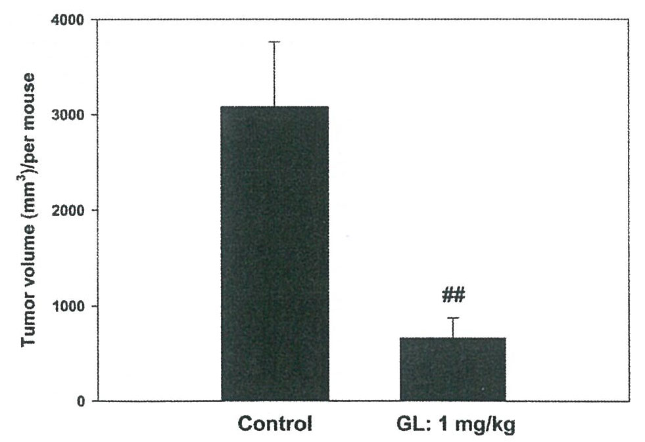
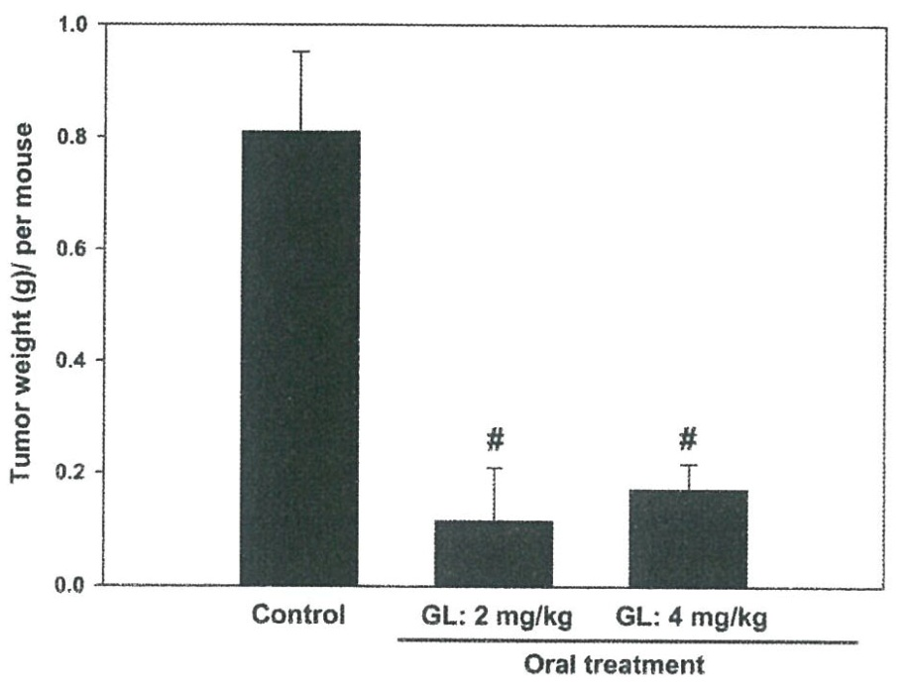
Results
Inhibit tumor proliferation
(peritoneal application)
Inhibit tumor proliferation
(oral application)
Oral application proved to be effective against androgen non-dependent cancer

Slide 13
Case 61-year-old patient (presently 71 years old)
Began observation at my clinic
Began GL oral application

Slide 14
前立腺がんに対するGL使用
GL Oral Application against Prostate Cancer
Year started | Age | Years of applica-tion | Dosage( CC) | PSA Starting PSA | Least PSA level | Other combined treatment
2004 | 80 | 1yr. | 10 | 278 | 1 | LH-RH
2005 | 67 | 2yr. | 15 | 24.4 | 13.3 | LH-RH （after application13.3⇒0.03）
2008 | 66 | 6yr. | 10 | 0.3 | 0.03 | after brachy therapy
2012 | 70 | 2yr. | 10～30 | 0.2 | 0.05 | daVinc
2013 | 69 | 1.5yr. | 30 | 16.1 | 10.5 | with other supplement
2014 | 71 | 4mos. | 15 | 10.1 | 6.9 | none
Data provided by Miyauchi Citrus Research Center, Ltd.

Slide 15
Issues to be considered
Considering this case, was Increased PSA at the beginning of this observation at my clinic a palindromia of cancer?
Considering decreased PSA by GL application, simply treated inflammation?
  Recommended strongly another biopsy
Unclear most adequate dosage of GL
What about testosterone level?
Require longer observation

